Slide 1
MOLECULAR BIOLOGY LABORATORY
BT 453
Laboratory No. 4
DNA Isolation
MBL. BT453

Slide 2
OBJECTIVES
To explain and understand the basic principle of DNA isolation from Dr
To understand that different types of DNA (e.g. Genomic DNA, RNA, plasmids) require different methods of isolation.
MBL. BT453

Slide 3
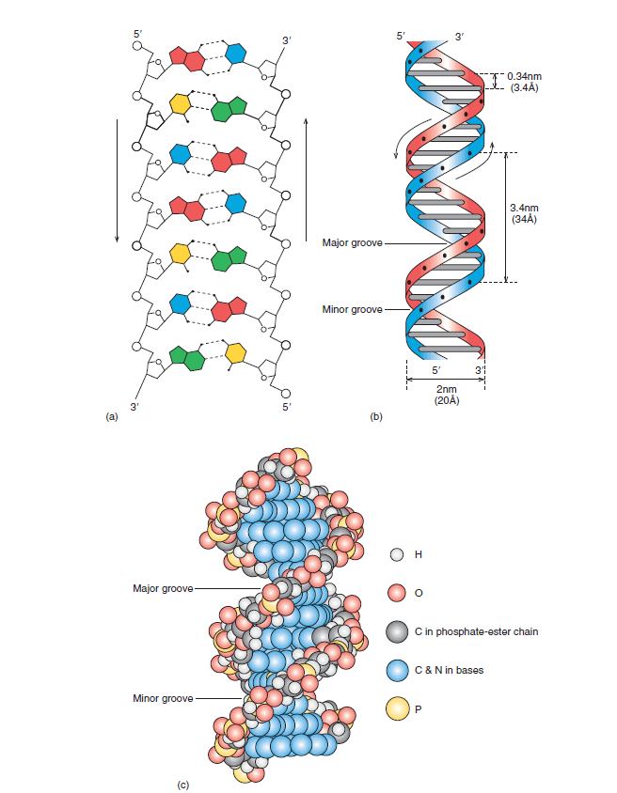
DNA
Weaver R. (2002) Molecular Biology
MBL. BT453

Slide 4
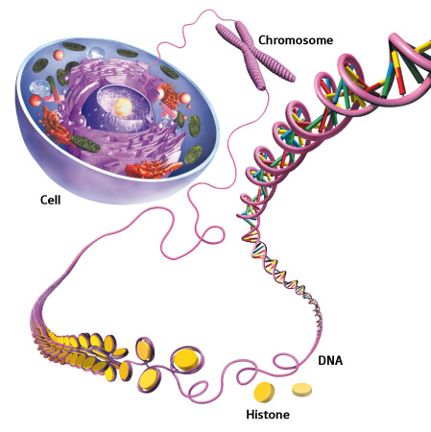
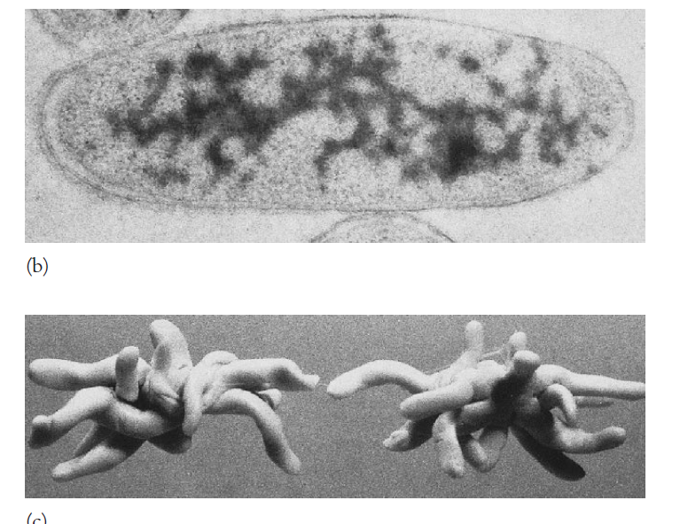
DNA inside cells
Eukaryotic cells
Prokaryotic cells
www.rikenresearch.riken.jp/eng/frontline/5514
Prescott M. (2002) Microbiology
MBL. BT453

Slide 5
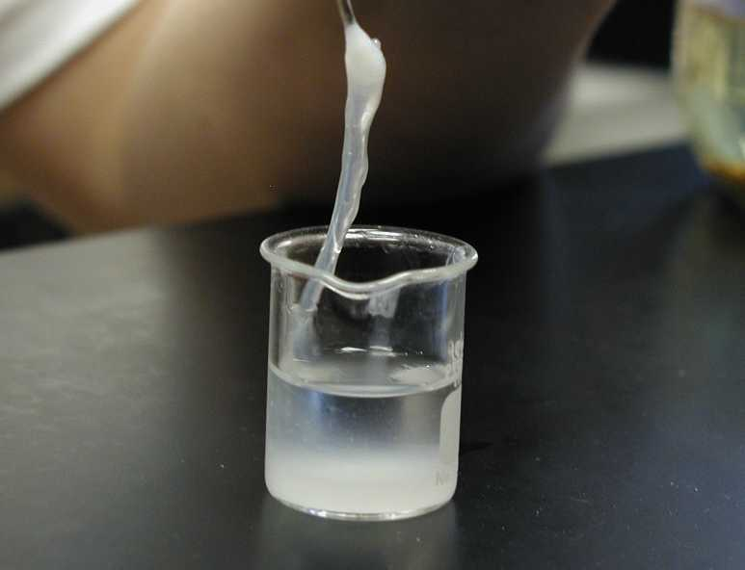
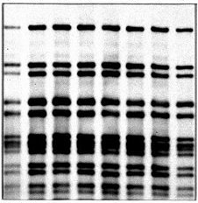
DEFINITION
DNA isolation is the extraction and purification of DNA (deoxyribonucleic acid)
After DNA is extracted, it is used as a template in further molecular techniques such as…
  PCR (polymerase chain reaction)
  RFLP (restriction fragment length polymorphism)
  Southern Blotting
  Ect …….
https://sites.google.com/a/luther.edu/genetics/students/eli-wallace/extraction-of-dna
http://www.michigan.gov/emergingdiseases/0,1607,7-186-25804_25810-76660--,00.html
MBL. BT453

Slide 6
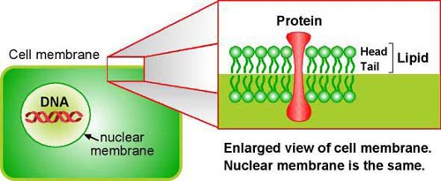
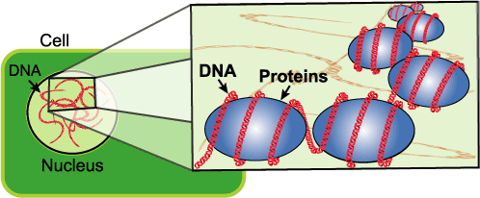
Major Steps in DNA isolation
Cell lysis
Removal of contaminates
DNA precipitation
DNA washing
DNA rehydration
http://gslc.genetics.utah.edu/units/activities/
extraction
http://gslc.genetics.utah.edu/units/activities/
extraction
MBL. BT453
6

Slide 7
To isolate DNA, You Must Remove …
Cell membrane
Cell wall
(plant, bacteria & fungi)
Cytoplasm
Nuclear membrane (animal & plant)
Proteins, polysaccharides & lipids
http://gslc.genetics.utah.edu/units/activities/
extraction
http://gslc.genetics.utah.edu/units/activities/
extraction
MBL. BT453

Slide 8
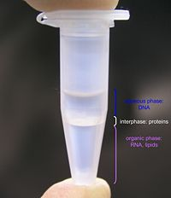
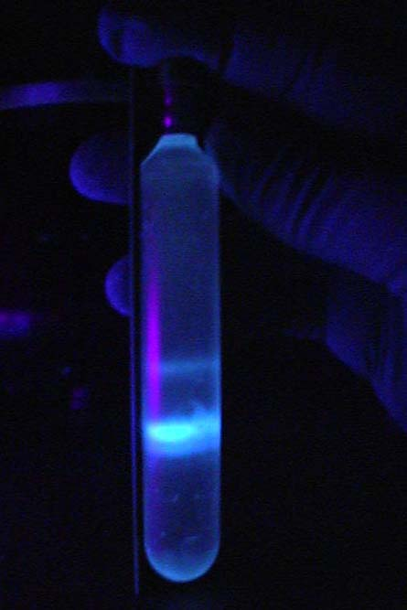
Types of Methods
Differential solubility
  Organic solvents
  Salting-out
Adsorption methods
Density gradient centrifugation
openwetware.org/wiki/Phenol/chloroform_extraction
https://classshares.student.usp.ac.fj
MBL. BT453

Slide 9
Differential solubility / Organic solvents
Bacteria pellting
&
resuspension in TE (Tris-EDTA)
EDTA binds up Mg++ ions, which is a necessary cofactor of DNases, which degrade the DNA. These ions interfere with the action of detergents. The EDTA binds to them(ions), sequestering them and preventing their interference.
TRIS – to maintain the pH of the DNA
A
Bacteria Lysis with
Detergent (SDS)
Proteinase k
NaCl
NaCl so that DNA is stabilised and remains as a double helix.
SDS which disrupts the lipid layers, helps to dissolve membranes & binds positive charges of chromosomal proteins (histones) to release the DNA into the solution.
Proteinase K to digest the proteins, deproteinization of DNA and inactivation of DNAse elevated temperature (Also 56ºC to inhibit degradation by DNAses).
B
Organic solvent extraction
(phenol:chloroform:isoamyl alcohol)
Phenol removes proteins
Chloroform & isoamyl alcohol remove phenol & lipids & carbohydrates
C
MBL. BT453

Slide 10
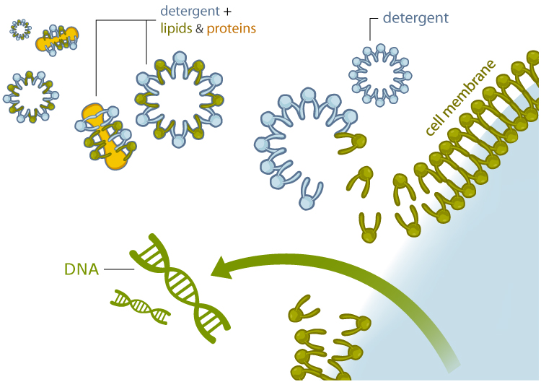
How detergent works
hs.hpisd.org/uploads/45/f100875.ppt
MBL. BT453

Slide 11
Differential solubility / Organic solvents
DNA precipitation by isopropanol/ethanol & sodium salt
Sodium Salt – Na+ ions bind to DNA, decreasing its negative charge allowing DNA molecules to come closer together and spool. NaCl is to keep the DNA in its double helix form, otherwise it would denature and become "ssDNA”.
Alcoholol – precipitate DNA which is repelled by nonpolar solutions.
D
DNA washing by 70% ethanol
70% ethanol - Wash the DNA to remove residual salts and other contaminants.
E
Air drying & resuspenstion in sterile H₂O or TE
Air drying removes ethanol
H₂O or TE dissolve DNA pellet
F
MBL. BT453

Slide 12

Differential solubility / Organic solvents
A
B
Centrifuge
Remove media & resuspend in TE
Add lysis buffer & proteinase K
Overnight bacterial culture
Bacteria pellet
Cells are lysed, DNA in solution
MBL. BT453

Slide 13
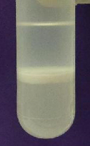
Differential solubility / Organic solvents
C
Mix thoroughly with an equal volume of organic solvent
Aqueous
Centrifuge
Collect aqueous phase
e.g. phenol, chloroform, or phenol:chloroform
Interphase
Organic
Perform additional extractions for increased purity
Crude lysate containing nucleic acids and other cell constituents
The aqueous phase contains water-soluble molecules, including nucleic acids. Proteins and lipids become trapped in the organic phase, and are thus separated away. Insoluble debris become trapped in the interphase between the two layers
MBL. BT453

Slide 14
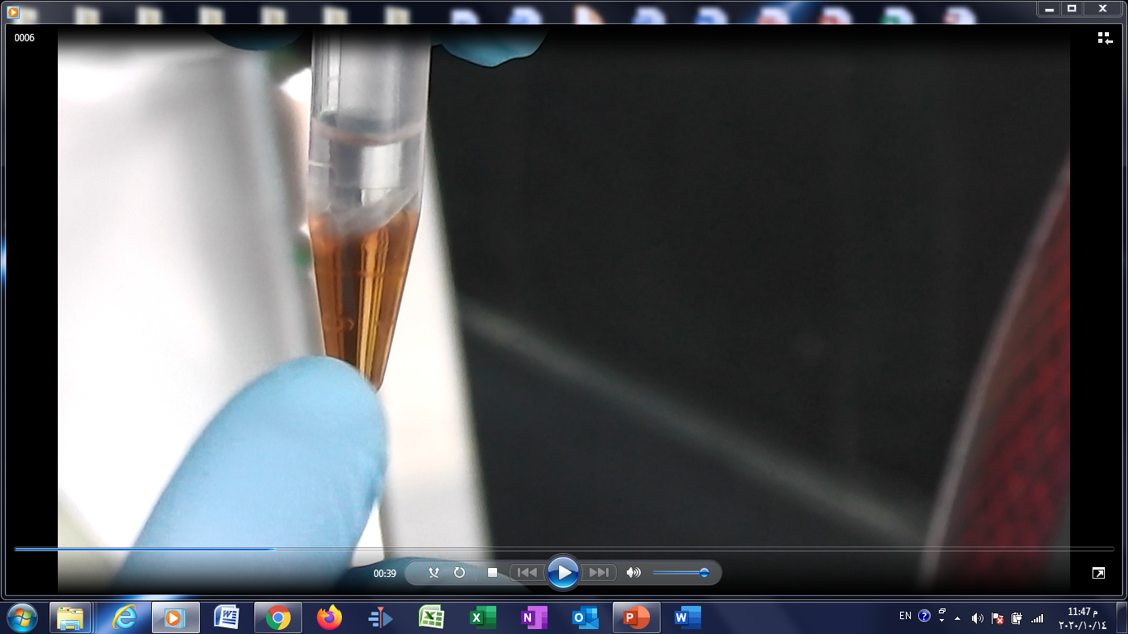
MBL

Slide 15
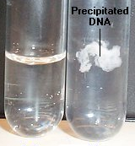
Differential solubility / Organic solvents
D
E
F
Supernatant
70% EtOH
Add alcohol & salt
Centrifuge
Wash
Centrifuge
Pellet
Dissolve pellet (H₂O, TE, etc.)
Before
After
Aqueous phase containing DNA
MBL. BT453

Slide 16
Laboratory No. 4
MBL. BT453

Slide 17
WORK FLOW CHART
Frozen fruit flies
Grind
Lysis
Partitioning of DNA & proteins
LABORATORY NO.5
Quantitation & Analysis
DNA precipitation
Agarose Gel electrophoresis
DNA Washing
DNA rehydration & storage
Spectrophotometer
Nanodrop
MBL. BT453

